Slide 1
Finding:
Cost of Capital Setting Performance Standards
Supply and Demand

Slide 2
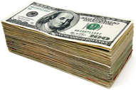

Cost of Capital Setting Performance Standards
Cost of Capital
Performance Standards
15% increase over previous year
25%
Aligning Performance Measures and Incentives
Capital
+
Compensation

Slide 3
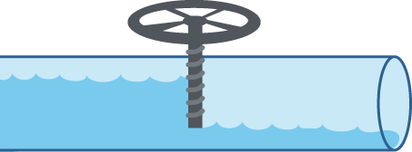



Supply and Demand
DEMAND
SUPPLY

